Slide 1

Microsoft Azure Stack Hub
Azure Stack Hub Automation
This work is licensed under a Creative Commons Attribution - ShareAlike 4.0 International Public License

Slide 2
Agenda
Azure Automation
Automation with Azure Stack Hub
Hybrid automation
Other automation options

Slide 3

Azure Automation
Automation as a service
Think Orchestrator or Azure Pack Service Automation, but in Azure
Automate repetitive or long-running processes
Script authoring environment
Uses PowerShell workflows
Combination of PowerShell 4.0 and WF
Uses integration modules, very similar to PowerShell Modules
Scheduling and monitoring
Execute scripts on a schedule
Review execution status on a dashboard

Slide 4
Azure Automation
What?
Orchestrate and automate time consuming repetitive tasks across multiple systems, including systems external to Azure platform
Perform development, testing, deployment, and management of automation resources from within Azure environment. There is no need for on-premises installation and configuration of infrastructure components
How?
Leverages PowerShell workflow
Supports integration modules to connect to Azure and external systems
Overall architecture and design of automation service stems out of SMA (Service Management Automation)

Slide 5
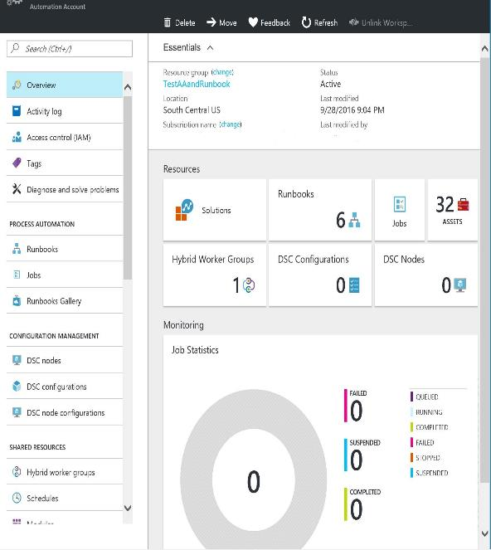
Azure Automation capabilities
Runbook authoring in Azure:
Create runbooks to automate all aspects of cloud operations, from deployment, monitoring, and optimizations
Highly available engine:
Support requirements for scale and H/A
Built on PowerShell workflow. Isolation for runbook jobs
Integration into other systems:
Import PS modules and create additional modules and runbooks for Azure services or to connect into 3rd party systems
Azure Stack Hub
Azure
CMDB
Automation
Monitoring
systems
Backup SQL Azure on a schedule
Patch Azure VMs without downtime
Remediate alert on a service
Staged deployment of a service
Billing
Change
control
systems
Ticketing
Anything ☺

Slide 6
Azure Automation in Azure Stack Hub?

Slide 7
Azure Stack Hub automation capabilities
Azure Stack Hub supports automation through the Azure Resource Manager (ARM), REST API and associated automation capabilities
Azure PowerShell, Azure CLI and Desired State Configuration (DSC), native APIs
Automation plays a critical role in Azure Stack Hub!
Workload onboarding
Administrative management
Azure DevOps
Infrastructure as Code
Resources lifecycle management

Slide 8
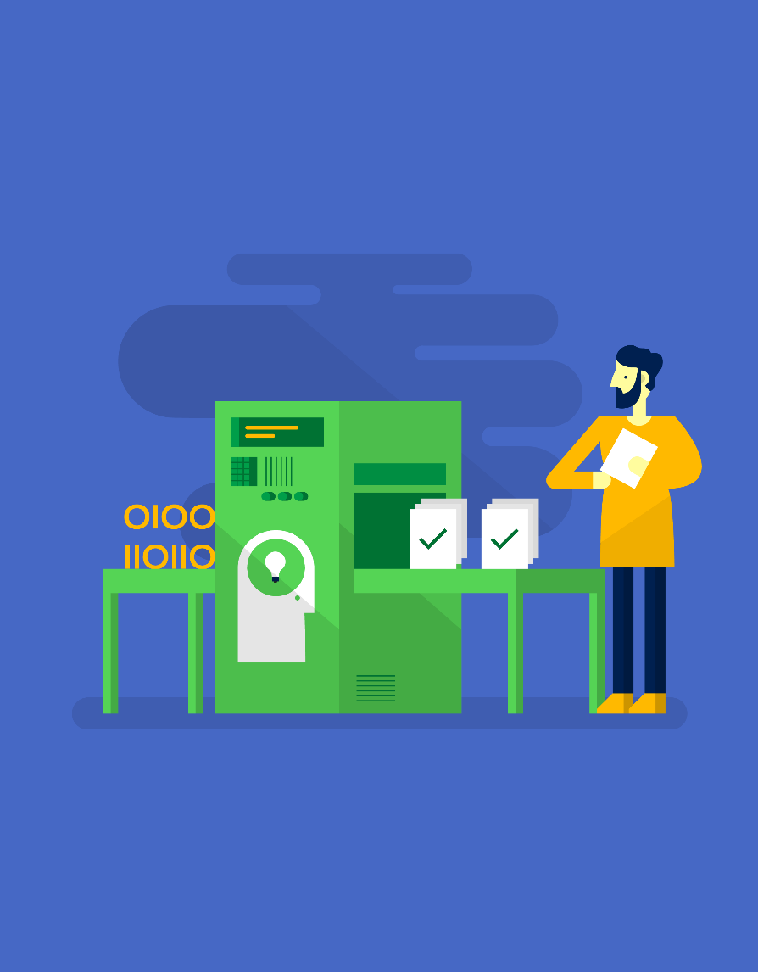
If you think you will do a task twice, automate it!

Slide 9
Can we use Azure Automation against Azure Stack Hub?

Slide 10
Azure Automation
It is not an Azure Stack Hub service but may be a future capability.
For “connected” Azure Stack Hub implementation running Azure Automation while targeting Azure Stack Hub can be used as an automation pattern in hybrid scenarios. (More detail coming up!)
For “disconnected” Azure Stack Hub implementation Service Management Automation (SMA) can be used as an IaaS workload to host runbooks.

Slide 11


Azure Automation
Author
Automate operational
tasks
Achieve
on-demand delivery
Integrate
Operate
Automation
Integration
Orchestration
Automation
Optimize and extend existing processes
Deliver flexible and reliable services
Lower costs and improve predictability
Integrate into existing systems with PowerShell integration modules
Extend by building PS modules to enable integrating into other systems
Accelerate time to value with flexible process workflows
Improve service reliability across multiple tools, systems, and department silos
Enable operations to focus on work that adds business value
Reduce error-prone manual activities while lowering costs

Slide 12
Typical automation scenarios
Patch/update/backup orchestration
Patch Azure IaaS VMs without downtime, leveraging Traffic Manager
Enable regeneration of storage account keys while avoiding downtime in the application
SQL backup on a schedule
Backup and restore IaaS VMs
Change control and provisioning
Deploy a VM on an Azure/on-premises cloud and enable monitoring for the VM
Deploy a new service to Azure and configure the end points for CPU and memory alerts
Deploy application from Git, run validation tests, and swap to production if tests pass
Monitor SharePoint online for an approval to update a service and update the service once approved
Monitoring and remediation
Alert on a VM then turn on tracing, collect logs, upload to Azure Storage, and make available in Visual Studio for troubleshooting
Monitor for when a new service gets created, and configure it for the right tracing/backup policy
Notify users of a subscription who have underutilized VMs and perform remediation

Slide 13
Hybrid automation using Azure Automation

Slide 14
Hybrid automation using Azure Automation
What?
Runbooks stored and managed in Azure Automation
Delivered and run against on-premises services including Azure Stack Hub
Why?
Single management solution for all resources: Azure, 3rd party cloud, or on-premises
Removes the need for on-premises management products. E.g., Orchestrator, Service Management Automation, etc.
How?
Runs on Windows Server 2012 and later
Uses Operations Management Suite (OMS), MS Management Agent (MMA) Channel, and Intelligence Pack Solution channel to deliver the runbook

Slide 15
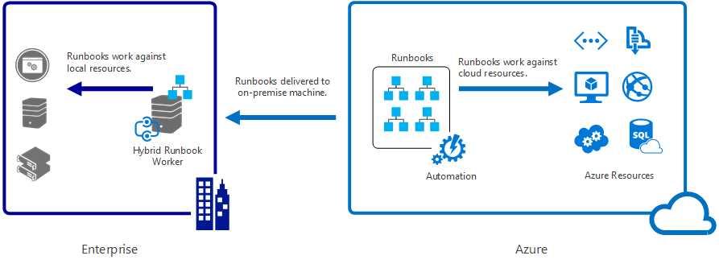
Hybrid Runbook Workers
http://aka.ms/Azure/Automation/Hybrid

Slide 16
Hybrid Runbook Worker notes
Hybrid Runbook Worker groups
Every Hybrid Runbook Worker is part of a group
Define multiple workers for high availability
Modules
Must import modules that integrate with resources
Assets
Can use the cloud assets: variables, credentials, connections, and certs
Scheduling (Jobs) not currently supported. Mitigation is to use a cloud runbook,
schedule it and call Start-AzureRMAutomationRunbook
Permissions
Hybrid Runbooks execute under Local System Account
Must provide your own authentication for non-Azure resources
Use a credential asset and retrieve at runtime using Get-AzureRMAutomationCredential
Read more

Slide 17
Additional fine points
Azure Scheduler
Provides more control over when runbooks run. E.g., on a specific day or in minute increments
Automation WebHooks
Start a runbook in response to an HTTP Request. Read more
Azure Automation DSC
Consistently deploy, reliably monitor, and automatically update the desired state of all your IaaS resources. Read More
Continuous deployment using Chocolatey
Allows you to install packages from a central repository of packages into a Windows system using the command line. Read More

Slide 18
Other Options for Automating IaaS VM Configuration

Slide 19

Tools to automate activities in Azure Stack Hub
Desired State Configuration (DSC)
Custom script extensions
Custom data integration (Linux Workloads)
3rd party tools
Chef
Puppet
Ansible

Slide 20
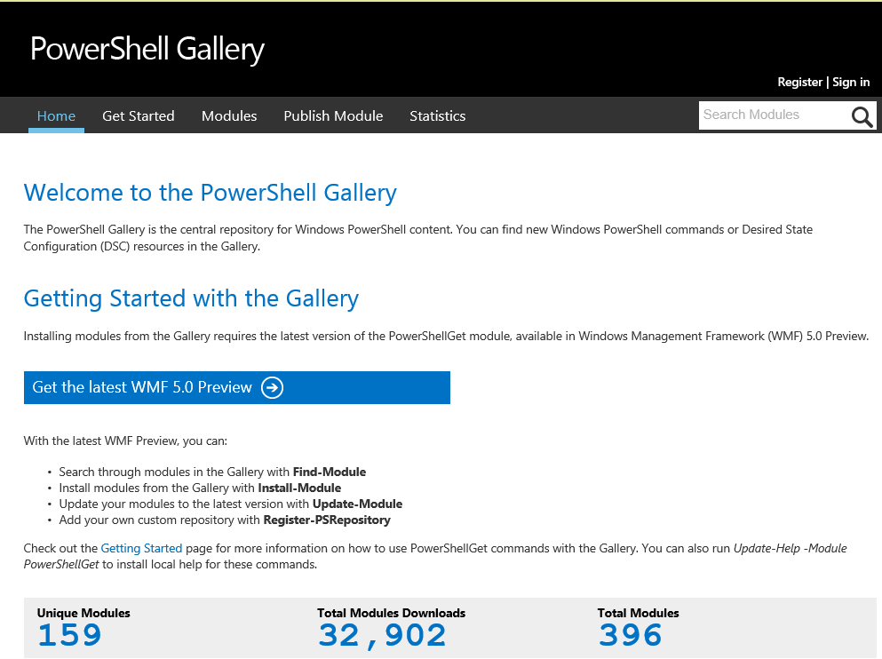
PowerShell Desired State Configuration
Simplifies configuration
Prevents configuration drift
Flexible deployment options
Enables continuous deployment
Modules available from PS Gallery

Slide 21
DSC enables…
Cloud scale
Reduced complexity – all VMs get the same configuration
On-demand system creation and tear down
Configuration as code
Conflict detection – non-conforming systems identified
Single source, multiple environment – can pull from ONE place
DevOps
Apply Dev practices to Operations – Devs can specify DSC policy
Continuous deployment

Slide 22
Extending automation with modules
Configure systems with PowerShell DSC
DSC resource modules enable configuration of your system using the Automation DSC pull service
Integrate into 3rd party systems
Dozens of 1st + 3rd party PowerShell modules exist today
Automation Integration Module = PowerShell Module + one extra optional file
Write your own modules
Write Automation modules for custom solutions
Simply by writing PowerShell modules in C# or PowerShell
Can convert anything with a REST API
Some best practices to make your modules light up in Automation

Slide 23
Azure Automation + DSC
PS DSC pull/reporting service hosted in the cloud
Manage physical hosts and VMs in any cloud or on-premises
Windows or Linux
Part of the Azure Automation service
PS DSC configuration, node configuration, node, and resource management
Import
Authoring
Compiling
Versioning
Distribution to nodes
Reporting
Easy node onboarding

Slide 24
Azure Automation + DSC
Staging
Authoring
MOF
MOF
Configuration
(script)
Node configuration
(MOF)
Reports
checksum
Rest endpoint
DSC
resources
Zip
Zip
Zip
Azure
Automation
Azure VM
Physical server
Azure Stack Hub
VM
On-premises
VM

Slide 25
DSC and runbooks – Better together
Use PS DSC to declaratively configure VMs/physical hosts
Use runbooks to orchestrate complex processes across systems
Use PS DSC within Azure Automation runbooks to configure machines as part of larger processes
Ex: The multi-step process of deploying new DSC configurations to production servers:
Monitor source control for new commits to DSC repository of an organization
When new commit, store the DSC in Azure Automation DSC, set up to be pulled by the stage environment VMs
Run test suite to confirm service in stage environment is functioning properly
If tests fail, alert developers
If tests pass, wait for maintenance window and then set up the DSC in Azure Automation to be pulled by production VMs, in a way that maintains service availability

Slide 26
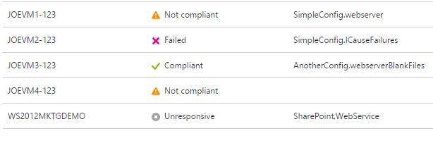
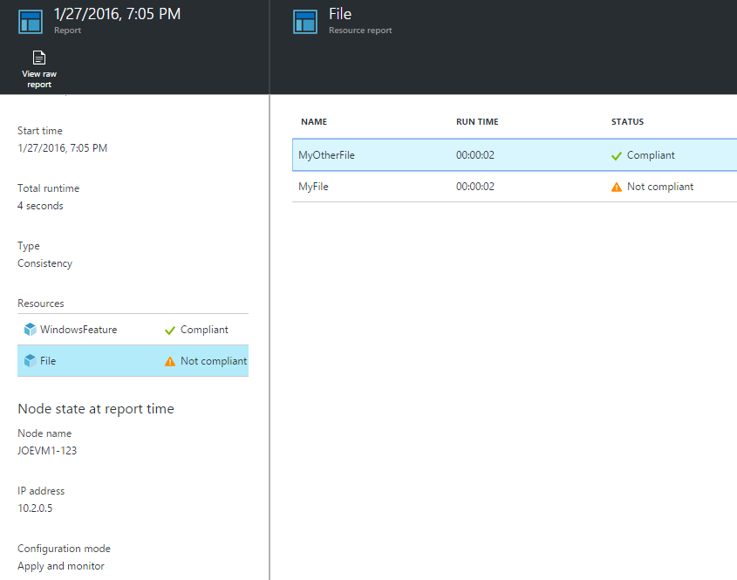
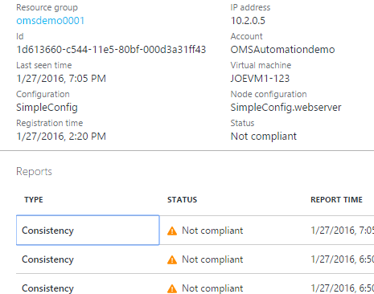
Azure Automation DSC
Reporting
Compliance status
Improved reporting
Support for report-only endpoint

Slide 27
DSC push model
“Make it So” Phase
(Declarative configuration is reified through imperative providers)
Staging Phase
Fully declarative configuration representation using DMTF standard MOF instances
Configuration is calculated for all nodes
Authoring Phase
(May include imperative as well as declarative code)
Local configuration store
PowerShell
Configuration Staging Area
(Contains DSC data)
Pull Server
(Contains DSC data and modules)
Parser and dispatcher
3rd party languages and tools
Resources
DSC Pull Model
When authoring in PowerShell:
Declarative syntax extensions
Schema-driven Intellisense
Schema validation (early-binding)
Resources implement changes:
Monotonic
Imperative
Idempotent

Slide 28
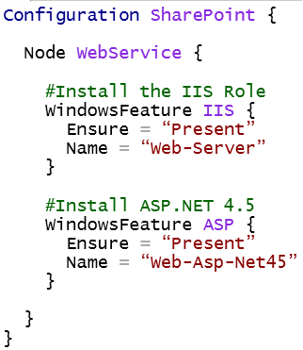

DSC terms and processes
Configuration scripts:
Node Configurations
(.MOF config document)
Nodes
Compiled
Applied to:
via push
or pull
1…N per
configuration script
1…N per
node configuration
1…N

Slide 29
Questions?

Slide 31
Appendix

Slide 32
Architecture
Service Management Portal
Authoring
Debugging
Operating
Runbook Workers
Runbook service
PowerShell modules
Web Service
REST oData web service
Authorizes users
SMA Database
Runbooks
Runbook resources
Tracks runbook job state

Slide 33
Runbook Worker – Architecture

Slide 34
Azure Automation
Windows Server, System Center, Azure
Microsoft
System Center
Azure
Azure Automation
Service Management Automation
Orchestrator
Azure DSC
Partners
OEMs
ISVs
Automation products
Management products
Windows Server
PowerShell
PowerShell Workflow
Just enough Admin
Desired State Configuration

Slide 35
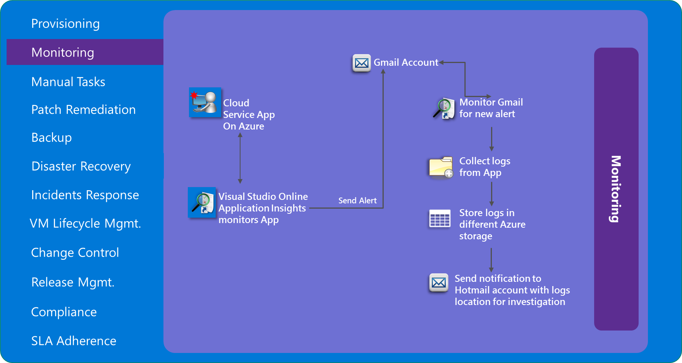
Enable automation across Azure resources and external systems

Slide 36
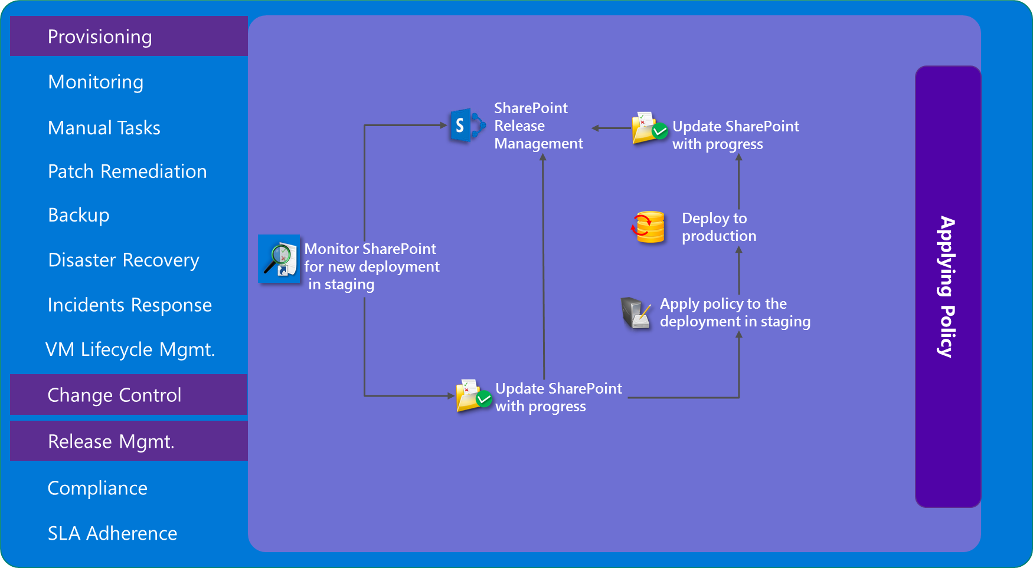
Enable automation across Azure resources and external systems

Slide 37
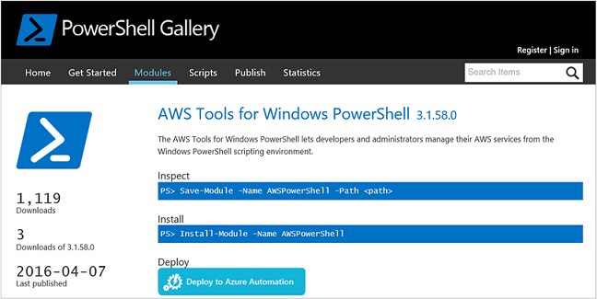
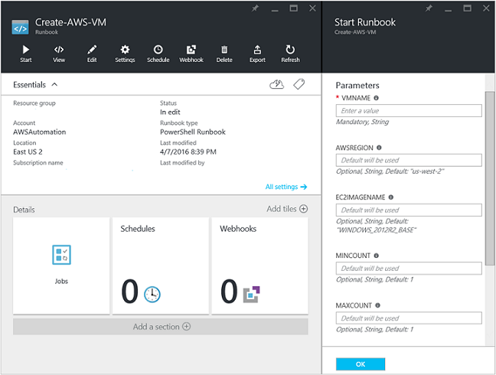
But wait, there’s more! AWS?????
Provision VMs in AWS
Need Automation Account
AWS Subscription
AWS PowerShell Module
Read more
Additional points
Enable verbose and progress records logging
Use AWSCred = Get-Credential to get Access Key ID and Secret Access Key for the password

Slide 38
More automation options

Slide 39
Chef, Puppet, and Ansible
Chef plug-in specific to Azure: knife-azure
Azure cookbook
Requires Azure RubyGem to work with Azure API
Chef and DSC integration
Chef Server 12, Chef Compliance available in Marketplace
Puppet supported modules for Azure and PowerShell DSC
Ansible-limited cloud modules for Azure

Slide 40
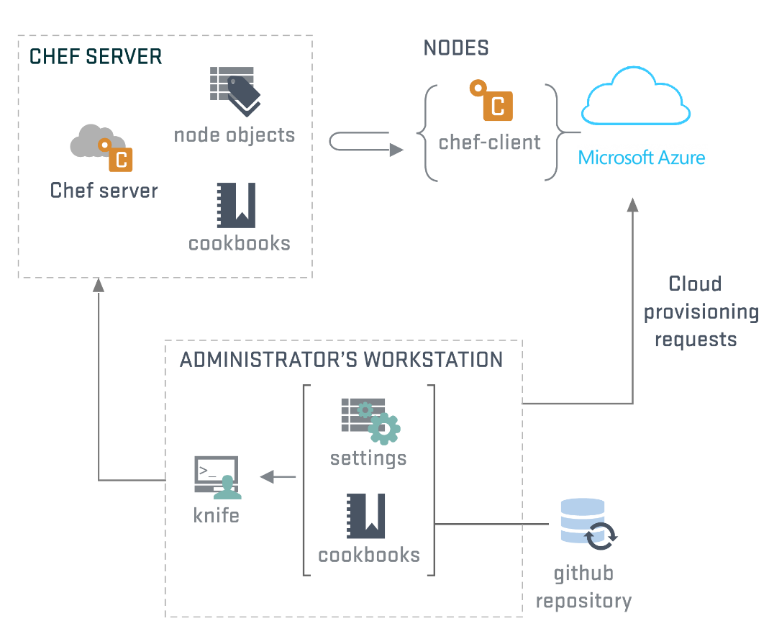
Chef and Azure

Slide 41
Chef and Azure
Two modes of operation
Chef to provision and configure
ARM to provision, Chef + DSC to configure
Today
Existing support for knife Azure is ASM
1.6.0 and higher will have ARM support
DSC support still buggy
Azure Cookbook has limited capabilities
ARM
Will require the use of a service principal
https://azure.microsoft.com/en-us/documentation/articles/resource-group-authenticate-service-principal/

Slide 42

Chef with PowerShell DSC
DSC provides platform and resources that can interface between other elements of the ecosystem
Expands manageable configuration points
PowerShell DSC Cookbook for Chef
Use dsc_script and dsc_resource resource to include PowerShell DSC configurations in Chef recipes
Consider if team is stronger in Ruby or PowerShell

Slide 43

Puppet on Azure
Create, stop, restart, and delete VMs and manage other resources with Puppet code using the Azure module
Requires Azure CLI
Requires Azure Gem client library for Ruby
Running the module on a Windows Agent is only supported with puppet-agent 1.3.0 (a part of Puppet Enterprise 2015.3) and newer

Slide 44
Compare and contrast
 | Chef | Puppet | Azure Automation DSC
Client-side | Agent | Agent | Local Configuration Manager
Azure Install | Chef VM Extension | Puppet VM Extension | DSC VM Extension
Server-side | Chef Server | Puppet Enterprise Server | Azure Automation DSC Pull Server
Azure Install | Marketplace VM | Marketplace VM | Azure Automation Account
Configuration | Cookbook/recipe/run list | Module/class/manifest | Node configuration/DSC resources
Language | Ruby + Domain Specific | Ruby + Domain Specific | PowerShell
Dev/test | Kitchen/knife/workstation | Puppet agent –t | LCM/PowerShell ISE
OS | Windows/Linux++ | Windows/Linux ++ | Windows ++/Linux
Community | Supermarket/cookbooks | Forge/modules/curated | PowerShell Gallery/DSC Resources

Slide 45
Architecture
Invocation
Point
Azure Portal
Azure Scheduler
PowerShell
REST API

Slide 46
Automation concepts

Slide 47
Automation in the portal
Automation account
It’s a container…Like a storage account or Web API account
Accounts can live in different regions
Runbooks
PowerShell Workflow that contains all the code
From the old Runbook terminology, which meant an ordered checklist for a process
Job
An execution instance of a runbook
Asset
A value that can be used within a runbook. E.g., Credentials, variables, connections

Slide 48
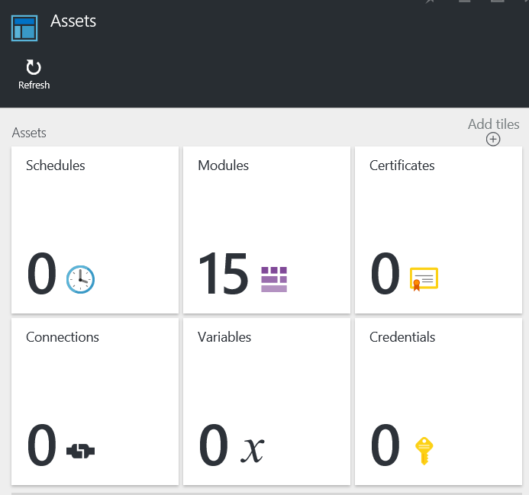
Intro to Automation assets
Create and edit via UX or API
Azure Automation objects available to all runbooks in the account
Module (cmdlets)
Schedule
Variable
Connection
Credential
CertificateJob
An execution instance of a runbook

Slide 49
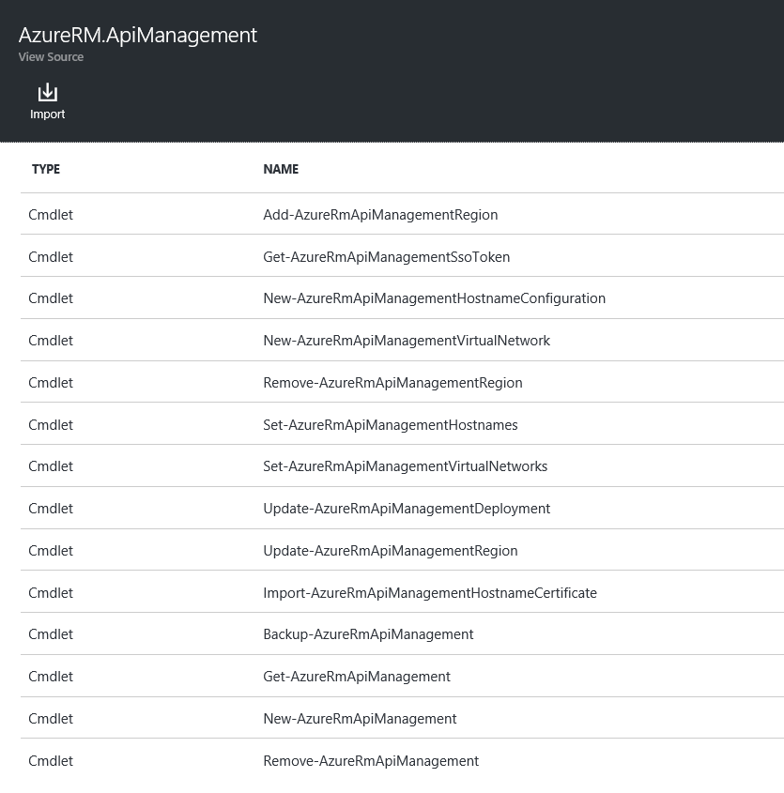
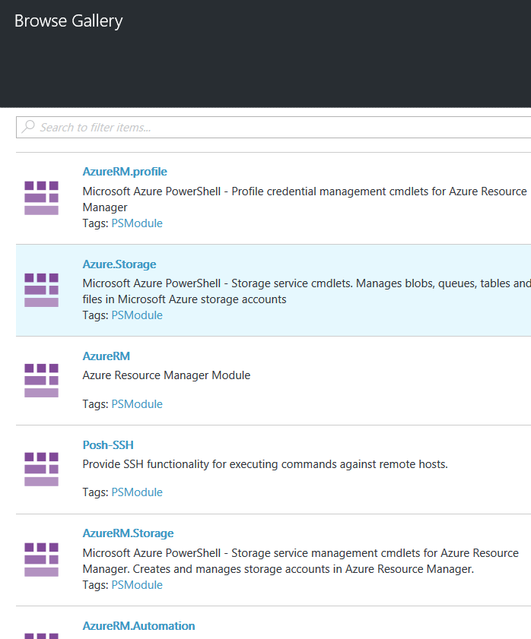
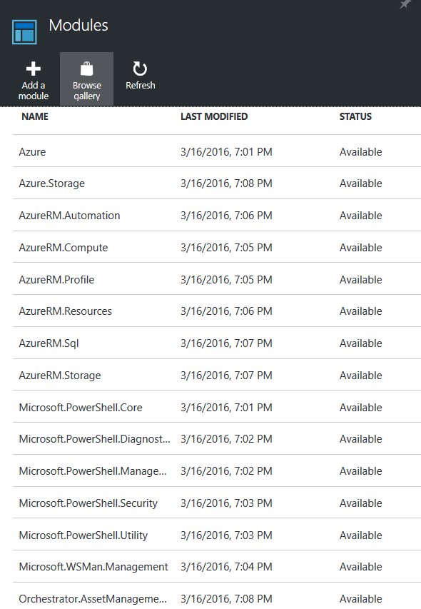
Integration modules
Integrate systems
Extend Azure Automation by importing PowerShell modules that function against other systems
Large ecosystem of PowerShell modules exist today
Integration Module = PowerShell Module + one extra optional file (JSON)
Read more on Authoring Integration Modules
New – AzureRmAutomationModule

Slide 50
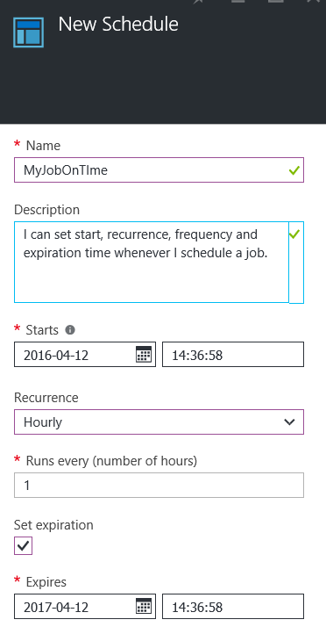
Schedule
Create a schedule
Then, link an existing runbook
Or create a schedule from a runbook
Additionally, can run from a server on-premises or a VM in Azure using Hybrid Runbook
New – AzureRmAutomationSchedule

Slide 51
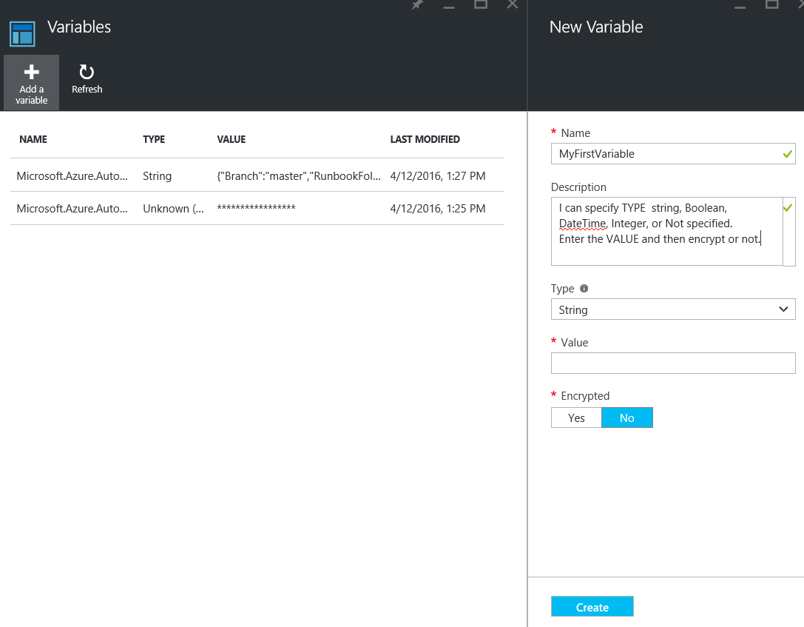
Variables
Global data to use across runbooks
Define and manage common global values for use in runbooks in the account
Change variables dynamically during runbook execution
Support for string, integer, boolean, datetime, and object types
Optional encryption
New – AzureRmAutomationVariable

Slide 52
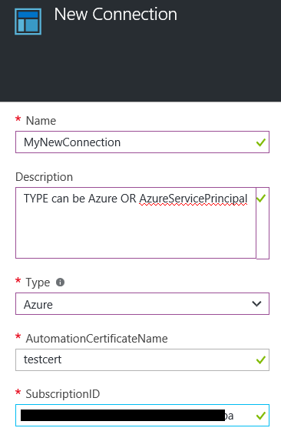
Connections
Store connection data for easy reuse
Group of variables needed to connect with a system (e.g., Azure)
Connection type name and fields are defined in Integration Modules (extra .json file)
Fields vary with requirements of the system being connected with
Fields may be encrypted (e.g. password)
New – AzureRmAutomationConnection

Slide 53
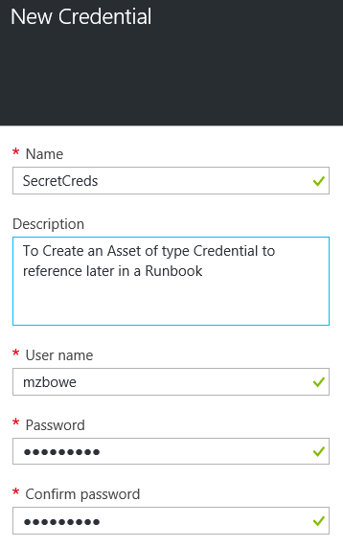
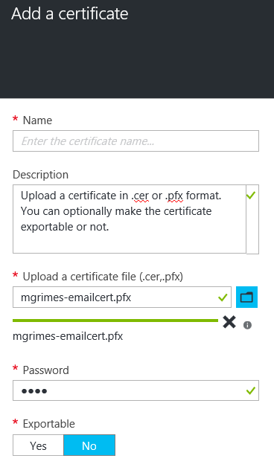
Credentials and certificates
Store secrets securely
Define secrets at the global level, reference them across runbooks
Easily change secrets referenced in many runbooks from one place
Stored encrypted in the database
New – AzureRmAutomationCredential New – AzureRmAutomationCertificate

Slide 54
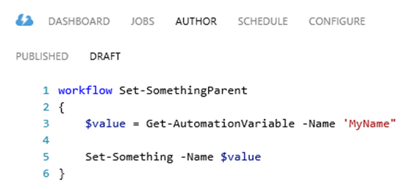
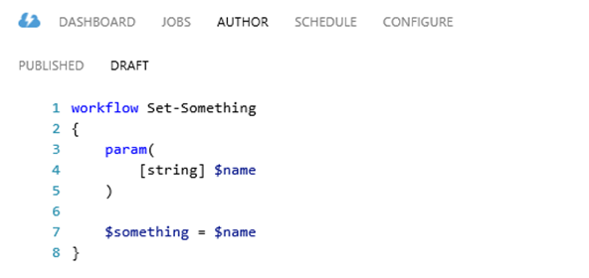
Using assets in runbooks
Recommended practice
When you have a hierarchy of nested runbooks, get assets in the parent runbook and pass the values of these settings into child runbooks
Benefit: Only need change in parent runbook when changes to referenced assets are required

Slide 55
Configuring automation

Slide 56
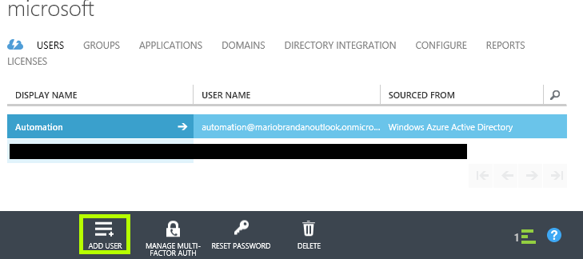
Setting up an execution account
Need an Azure AD Account that will be used as the principal that will execute Runbooks
Create a regular Azure Account in the Azure AD for your subscription

Slide 57
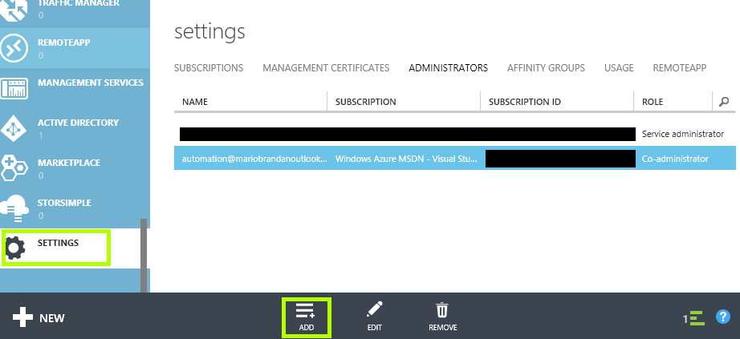
Grant the account co-admin privileges
Settings > Administrators > Add
Enter the email address of the account you just created
Afterwards, log in as that user and change the temporary password

Slide 58
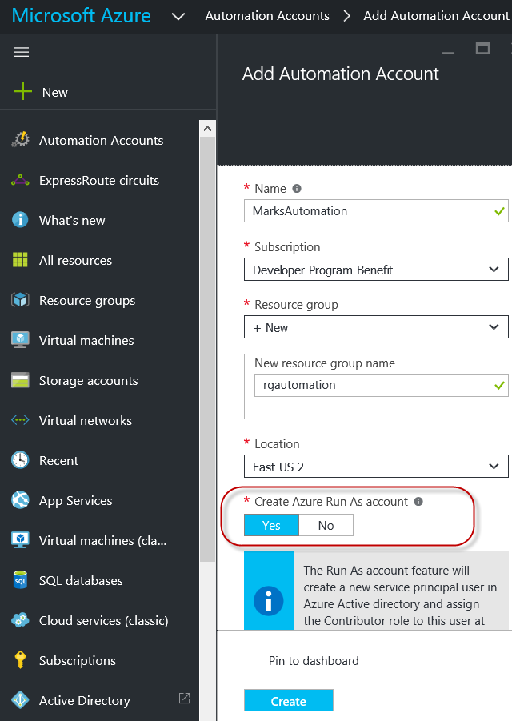
Automation account
A container for your Azure Automation resources, like a storage account
Authenticate with new Run As Account or use existing Automation Account

Slide 59
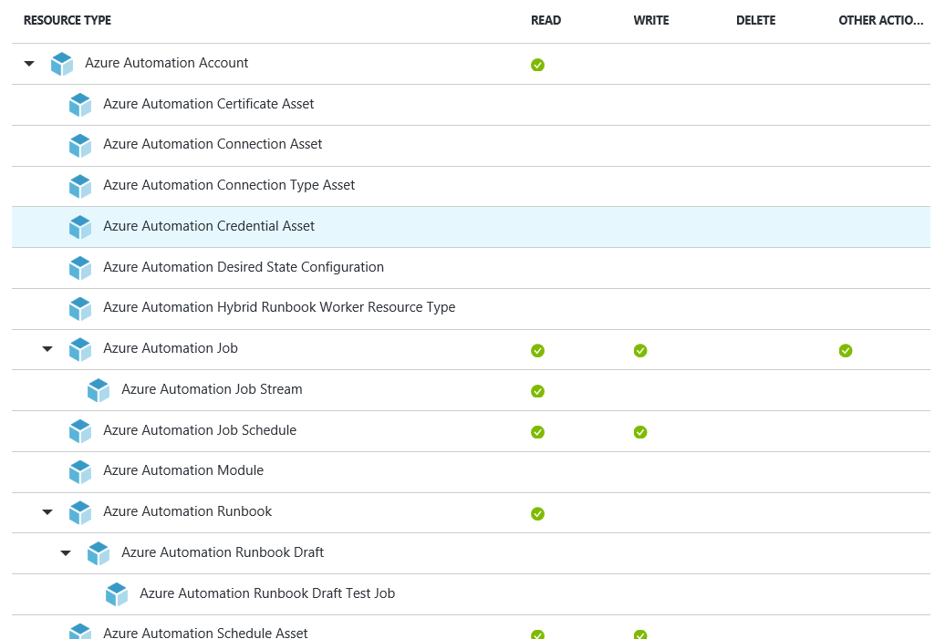
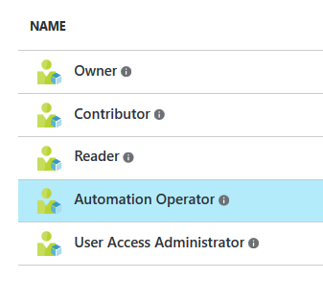
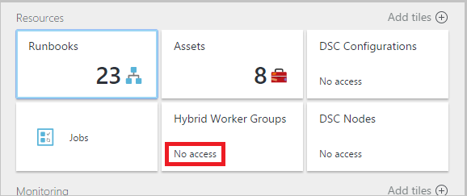
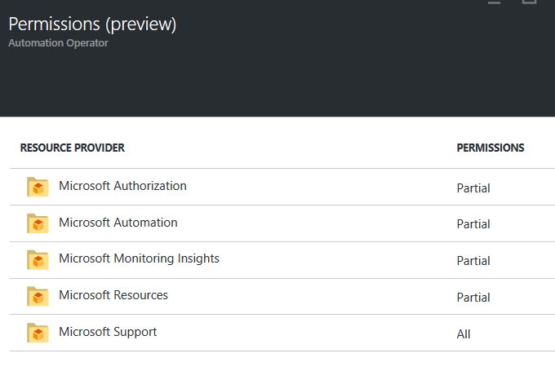
Automation operator role
Allows tasks, such as:
Start
Stop
Suspend
Resume
Reschedule jobs
Can allow members to execute runbooks, while protecting other assets, e.g. runbooks and credential assets

Slide 60
Runbook management cmdlets samples
#List all Automation cmdlets
Get-Command -Module AzureRM.Automation
#Start a runbook
Start-AzureRmAutomationRunbook -Name Stop-AllAzureVM – ResourceGroupName rgautomation -AutomationAccountName MarksAutomation
#Get the status of a job
Get-AzureRmAutomationJob -Id 05754363-0071-47d9-957d- 9d316f6d0924 –ResourceGroupName rgautomation – AutomationAccountName MarioBrandanAutomation
Just use PowerShell ISE and all the commands are there!

Slide 61
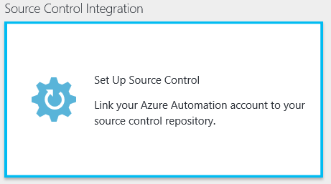
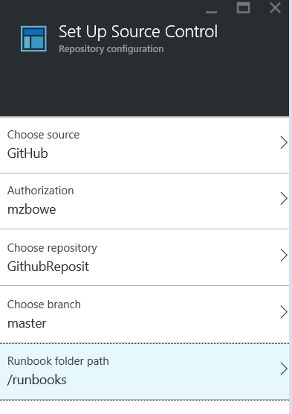
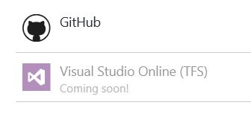
Set up source control
Author
Create PowerShell Workflow runbooks
Call existing runbooks in library
Manage, browse, and insert assets in runbooks
Modules and activities
Credentials (PowerShell credentials and certificates)
Variables (standard and encrypted)
Connections
Schedules

Slide 62
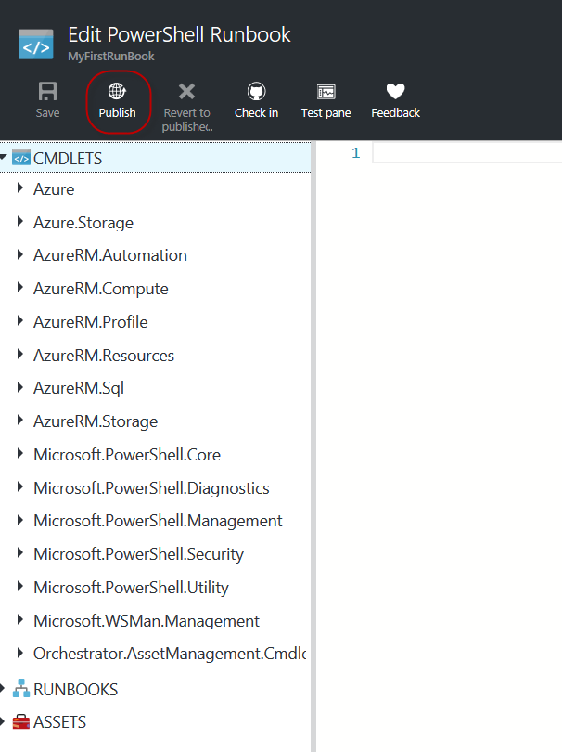
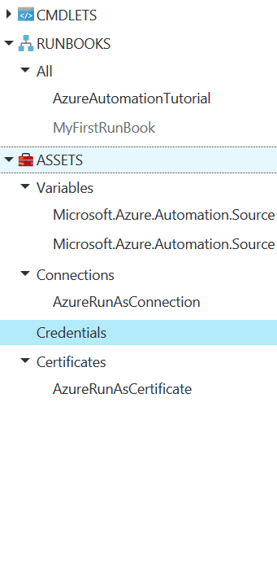
Runbook publishing
Author
Create PowerShell Workflow runbooks
Call existing runbooks in library
Manage and browse and insert assets in runbooks
Modules and activities
Credentials (PowerShell credentials and certificates)
Variables (standard and encrypted)
Connections
Schedules

Slide 63
Resource modeling
Model/design resources before writing “any” code
Resource modeling should satisfy 4 basic principles:
Identifiable: Uniquely and reliably identify resource instance (e.g. key)
Expressible: State the desired state of the resource, independent of the control flow
Testable: Accurately test if the resource is in desired state (Test-TargetResource)
Enactable: Make changes that will converge actual state to the desired state (Set-TargetResource)
General focus is about the end state, not the transient state

Slide 64
Modeling the sub-system
Easier to model physical entity rather than logical entity
Physical entity – Firewall Rule, Registry
Logical entity – Domain, Cluster, SaaS
Modeling logical entity that spans multi-machine
Consider entity as a property of a resource vs. a resource
E.g.: Cluster as a property of a node vs. a cluster resource that contain nodes
Modeling SaaS as a logical entity
Consider entity as a resource and service as the target node
E.g.: AzureSQLServer is the resource, and Azure service as the target node
Can have multiple resource that apply to same sub-system
E.g.: Firewall Rule and Firewall Profile

Slide 65
MOF-based resource structure
Folder: <Module Name>
Packaging Container
DSC Resource Designer
http://www.powershellgallery.com/packages/xDSCResourceDesigner/
File: <Module Name.psd1>
Module manifest
Folder: DSCResources
Can contain multiple resources
Folder: <Resource Name>
Definition and implementation of a resource
Folder: <Resource Name>
Definition and implementation of a resource
File: <Resource Name>.schema.mof
Resource definition
File: <Resource Name>.schema.mof
Resource definition
File: <Resource Name>.psm1
Resource implementation
File: <Resource Name>.psm1
Resource implementation

Slide 66
Class-based resource structure Simpler to set up, manage, and use
Folder: <Module Name>
Packaging container
MOF-based resource
# of Folders = n+2
# of Files = 2n+1
Total # of Items = 3n+3
Class-based resource
# of Folders = 1
# of Files = n+1
Total # of Items = n+2
File: <Module Name.psd1>
Module manifest
File: <Resource Name>.psm1
Resource definition & implementation
File: <Resource Name>.psm1
Resource definition & implementation

Slide 67
Composite resource
Configuration that acts as resource in other configurations
Enables modeling of hierarchy of resources
E.g.: Deploying SQL, Deploying VS, Creating HA DC
Provides abstraction from the underlying building blocks
Enables modelling of the sub-system to appropriate level
Enables code reuse
Configuration parameters → Resource properties
Placement is identical to simple resources
Requires <ResourceName>.psd1 and <ResourceName>.schema.psm1 file
In .psd1, RootModule = ‘<ResourceName>.schema.psm1’

Slide 68
Simple vs. composite resource
Folder: <Module Name>
Packaging container
File: <Module Name.psd1>
Module manifest
Folder: DSCResources
Can contain multiple resources
Folder: <Simple Resource Name>
Definition and implementation of a resource
Folder: <Composite Resource Name>
Definition and implementation of a resource
File: <Resource Name>.schema.mof
Resource definition
File: <Resource Name>.schema.psm1
Resource definition & implementation
File: <Resource Name>.psm1
Resource implementation
File: <Resource Name>.psd1
Module Manifest

Slide 69
Azure VM custom script extension Introduction
Scripts copied from Azure storage to VM and executed locally
Prerequisites:
Azure VM Agent must be running
Must be using Azure PS module 8.0 or higher
Scripts must be uploaded to Blob Storage
Multiple script’s must be ‘chained’ in code, only one is executed by extension

Slide 70
DSC decouples …
Intent
What: Structural configuration
Stays same irrespective of the environment
Where: Environmental configuration
Changes as system goes through different env.
Dev → Test → Production
Configuration
Intent
DSC Engine
Dependency resolution
Logging and error handling
Reboot resiliency
Repeatable automation
Make it so
How: DSC resources
Do the heavy lifting in an idempotent way
Resources
Technology-specific

Slide 71
Azure VM custom script extension Why and how
Why Azure VM Custom Script Extension:
Execute scripts on existing Azure VMs without the need of an endpoint or PowerShell remoting
Execute script on new VMs at build time
Process:
Create script and upload to Azure Blob storage
Use Set-AzureRmVMCustomScriptExecution to execute script

Slide 72
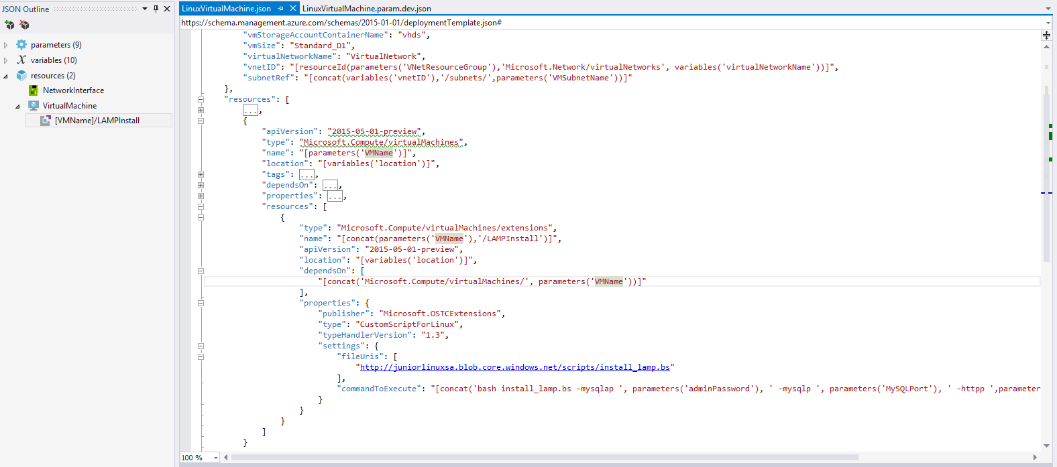
Sample custom script extension template section
Code Sample

Slide 73
Linux custom data integration
Linux Custom Data integration, a feature known as “cloud-init,” was introduced by Key Players in the Open Source and OpenStack communities used handle early initialization of cloud instances.
In Windows, there is a concept called an Unattend.xml file, which is used to complete a sysprep image of Windows. With this file, you can perform multiple tasks like “Adding Windows Feature,” “Adding Administrator Users from Domain,” “Joining Domain,” etc. The Custom Data file on a “cloud-init” enabled instance of Linux also can perform similar tasks. There is no concept of image completion on Linux images, so one of the ways to provision and distinguish one Linux instance from the other is leverage technologies like “cloud-init.”
Some of the capabilities of cloud-init are listed in this table.
Setting a default locale | Setup and run puppet
Setting a instance hostname | Add apt repositories
Including users and groups | Run commands on first boot
Writing out arbitrary files | Alter the completion message
Adding a yum repository | Install arbitrary packages
Configure an instances trusted CA certificates | Run apt or yum upgrade
Configure an instances resolv.conf | Adjust mount points mounted
Install and run chef recipes | Call a url when finished
Reboot/poweroff when finished | Configure instances ssh-keys

Slide 74
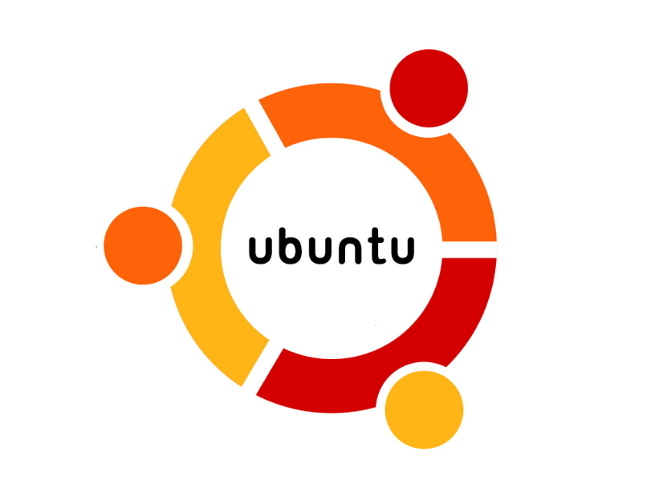
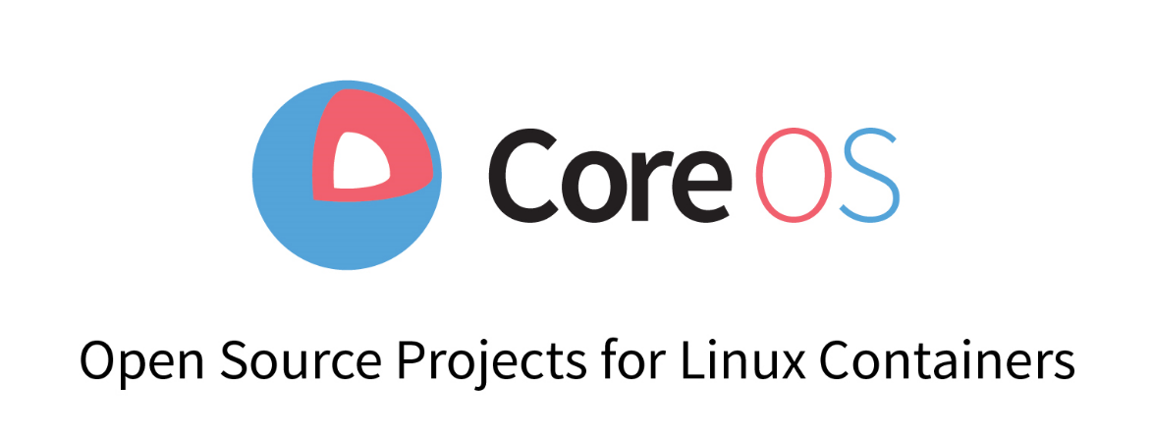
cloud-init Integration in Azure
The following distributions currently support cloud-init integration out of the box:
Ubuntu
CoreOS

Slide 75
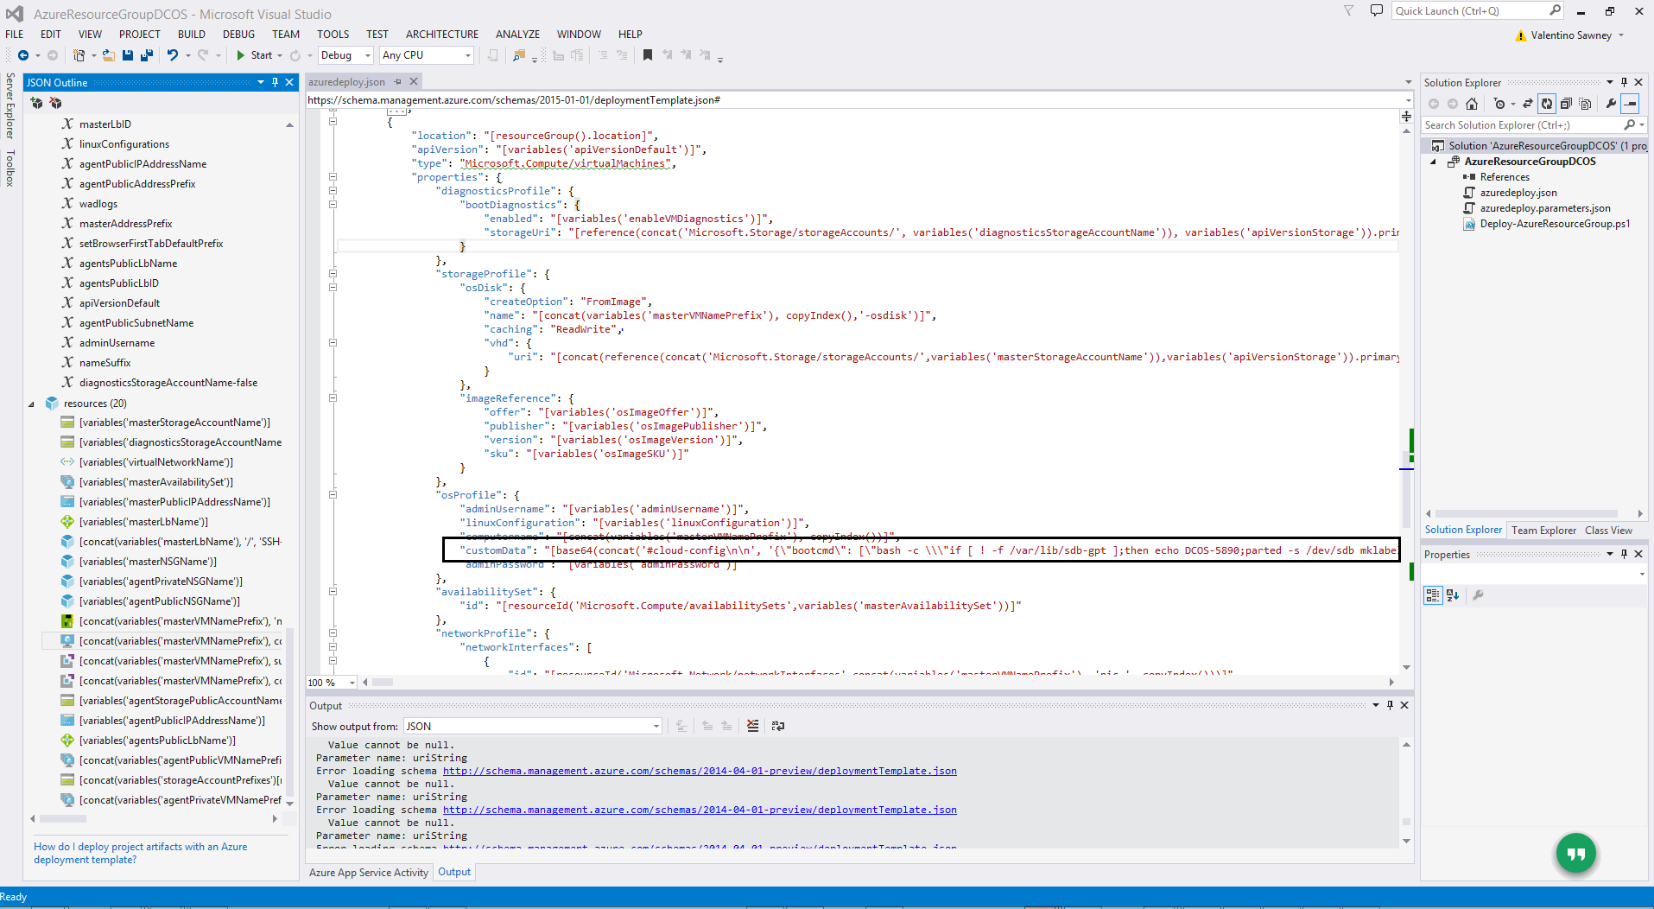
Sample custom data template section

